Slide 1
A New String Matching Algorithm Based on Logical Indexing
The 5th International Conference on Electrical Engineering and Informatics 2015 (ICEEI 2015)
Author: Daniar Heri Kurniawan、Rinaldi Munir
Presenter: Cheng-Feng Ke
Date: 2017/10/25
Department of Computer Science and Information Engineering
National Cheng Kung University, Taiwan R.O.C.
Notes:
1

Slide 2
INTRODUCTION
Simple
Pattern
Margin
Table
Margin
Shift (2)
Occurrence
Table
Match
Shift (1)
Char
Table
Full
Shift (3)

Slide 3
Margin Table
Pattern
0 | 1 | 2 | 3 | 4 | 5 | 6
B | A | C | X | A | B | A
Margin Table
0 | 1 | 2 | 3 | 4 | 5 | 6
 |  |  |  |  |  | 0

Slide 4
Margin Table
Pattern
0 | 1 | 2 | 3 | 4 | 5 | 6
B | A | C | X | A | B | A
Margin Table
0 | 1 | 2 | 3 | 4 | 5 | 6
 |  |  |  |  | 0 | 0

Slide 5
Margin Table
Pattern
0 | 1 | 2 | 3 | 4 | 5 | 6
B | A | C | X | A | B | A
Margin Table
0 | 1 | 2 | 3 | 4 | 5 | 6
 |  |  |  | 2 | 0 | 0

Slide 6
Margin Table
Pattern
0 | 1 | 2 | 3 | 4 | 5 | 6
B | A | C | X | A | B | A
Margin Table
0 | 1 | 2 | 3 | 4 | 5 | 6
2 | 2 | 2 | 2 | 2 | 0 | 0

Slide 7
Occurrence Table
Pattern
0 | 1 | 2 | 3 | 4 | 5 | 6
B | A | C | X | A | B | A
Occurrence Table
0 | 1 | 2 | 3 | 4 | 5 | 6
 | -1 |  |  | 1 |  | 4

Slide 8
Occurrence Table
Pattern
0 | 1 | 2 | 3 | 4 | 5 | 6
B | A | C | X | A | B | A
Occurrence Table
0 | 1 | 2 | 3 | 4 | 5 | 6
-1 | -1 |  |  | 1 | 0 | 4

Slide 9
Occurrence Table
Pattern
0 | 1 | 2 | 3 | 4 | 5 | 6
B | A | C | X | A | B | A
Occurrence Table
0 | 1 | 2 | 3 | 4 | 5 | 6
-1 | -1 | -1 | -1 | 1 | 0 | 4

Slide 10
Char Table
Pattern
0 | 1 | 2 | 3 | 4 | 5 | 6
B | A | C | X | A | B | A
Char Table
A | B | C | X | Other chars
6 | 5 | 2 | 3 | -1
Notes:
每個字元從 Pattern 後面算起來，第一次出現的地方。

Slide 11
Search
Margin Table
0 | 1 | 2 | 3 | 4 | 5 | 6
2 | 2 | 2 | 2 | 2 | 0 | 0
0 | 1 | 2 | 3 | 4 | 5 | 6 | 7 | 8 | 9 | 0 | 1 | 2 | 3 | 4 | 5 | 6 | 7 | 8 | 9 | 0 | 1 | 2 | 3 | 4 | 5 | 6 | 7
B | A | C | X | Y | B | A | A | B | A | B | A | B | A | X | B | A | A | C | A | A | B | A | C | X | A | B | A
B | A | C | X | A | B | A
 |  |  |  | ↑
Text
Pattern
Pointer
Occurrence Table
0 | 1 | 2 | 3 | 4 | 5 | 6
-1 | -1 | -1 | -1 | 1 | 0 | 4
Char Table
A | B | C | X | Other chars
6 | 5 | 2 | 3 | -1
Notes:
藍色是 pattern 裡面 unmatch 的部分。

Slide 12
Search
Margin Table
0 | 1 | 2 | 3 | 4 | 5 | 6
2 | 2 | 2 | 2 | 2 | 0 | 0
0 | 1 | 2 | 3 | 4 | 5 | 6 | 7 | 8 | 9 | 0 | 1 | 2 | 3 | 4 | 5 | 6 | 7 | 8 | 9 | 0 | 1 | 2 | 3 | 4 | 5 | 6 | 7
B | A | C | X | Y | B | A | A | B | A | B | A | B | A | X | B | A | A | C | A | A | B | A | C | X | A | B | A
B | A | C | X | A | B | A
 |  |  |  | ↑
Text
Pattern
Pointer
Occurrence Table
0 | 1 | 2 | 3 | 4 | 5 | 6
-1 | -1 | -1 | -1 | 1 | 0 | 4
Char Table
A | B | C | X | Other chars
6 | 5 | 2 | 3 | -1

Slide 13
Search
Margin Table
0 | 1 | 2 | 3 | 4 | 5 | 6
2 | 2 | 2 | 2 | 2 | 0 | 0
0 | 1 | 2 | 3 | 4 | 5 | 6 | 7 | 8 | 9 | 0 | 1 | 2 | 3 | 4 | 5 | 6 | 7 | 8 | 9 | 0 | 1 | 2 | 3 | 4 | 5 | 6 | 7
B | A | C | X | Y | B | A | A | B | A | B | A | B | A | X | B | A | A | C | A | A | B | A | C | X | A | B | A
B | A | C | X | A | B | A
 |  |  |  | ↑
Text
Pattern
Pointer
Occurrence Table
0 | 1 | 2 | 3 | 4 | 5 | 6
-1 | -1 | -1 | -1 | 1 | 0 | 4
Char Table
A | B | C | X | Other chars
6 | 5 | 2 | 3 | -1

Slide 14
Search
Margin Table
0 | 1 | 2 | 3 | 4 | 5 | 6
2 | 2 | 2 | 2 | 2 | 0 | 0
Margin Shift
0 | 1 | 2 | 3 | 4 | 5 | 6 | 7 | 8 | 9 | 0 | 1 | 2 | 3 | 4 | 5 | 6 | 7 | 8 | 9 | 0 | 1 | 2 | 3 | 4 | 5 | 6 | 7
B | A | C | X | Y | B | A | A | B | A | B | A | B | A | X | B | A | A | C | A | A | B | A | C | X | A | B | A
 |  |  |  |  | B | A | C | X | A | B | A
 |  |  |  |  |  |  |  |  |  |  | ↑
Text
Pattern
Pointer
Occurrence Table
0 | 1 | 2 | 3 | 4 | 5 | 6
-1 | -1 | -1 | -1 | 1 | 0 | 4
Char Table
A | B | C | X | Other chars
6 | 5 | 2 | 3 | -1

Slide 15
Search
Margin Table
0 | 1 | 2 | 3 | 4 | 5 | 6
2 | 2 | 2 | 2 | 2 | 0 | 0
Index of char in pattern = 3
0 | 1 | 2 | 3 | 4 | 5 | 6 | 7 | 8 | 9 | 0 | 1 | 2 | 3 | 4 | 5 | 6 | 7 | 8 | 9 | 0 | 1 | 2 | 3 | 4 | 5 | 6 | 7
B | A | C | X | Y | B | A | A | B | A | B | A | B | A | X | B | A | A | C | A | A | B | A | C | X | A | B | A
 |  |  |  |  | B | A | C | X | A | B | A
 |  |  |  |  |  |  |  | ↑
Text
Pattern
Pointer
5 > 3
0 < 3
Occurrence Table
0 | 1 | 2 | 3 | 4 | 5 | 6
-1 | -1 | -1 | -1 | 1 | 0 | 4
Char Table
A | B | C | X | Other chars
6 | 5 | 2 | 3 | -1

Slide 16
Search
Margin Table
0 | 1 | 2 | 3 | 4 | 5 | 6
2 | 2 | 2 | 2 | 2 | 0 | 0
0 | 1 | 2 | 3 | 4 | 5 | 6 | 7 | 8 | 9 | 0 | 1 | 2 | 3 | 4 | 5 | 6 | 7 | 8 | 9 | 0 | 1 | 2 | 3 | 4 | 5 | 6 | 7
B | A | C | X | Y | B | A | A | B | A | B | A | B | A | X | B | A | A | C | A | A | B | A | C | X | A | B | A
 |  |  |  |  | B | A | C | X | A | B | A
 |  |  |  |  |  |  |  | ↑
Text
Pattern
Pointer
Occurrence Table
0 | 1 | 2 | 3 | 4 | 5 | 6
-1 | -1 | -1 | -1 | 1 | 0 | 4
Char Table
A | B | C | X | Other chars
6 | 5 | 2 | 3 | -1

Slide 17
Search
Margin Table
0 | 1 | 2 | 3 | 4 | 5 | 6
2 | 2 | 2 | 2 | 2 | 0 | 0
0 | 1 | 2 | 3 | 4 | 5 | 6 | 7 | 8 | 9 | 0 | 1 | 2 | 3 | 4 | 5 | 6 | 7 | 8 | 9 | 0 | 1 | 2 | 3 | 4 | 5 | 6 | 7
B | A | C | X | Y | B | A | A | B | A | B | A | B | A | X | B | A | A | C | A | A | B | A | C | X | A | B | A
 |  |  |  |  | B | A | C | X | A | B | A
 |  |  |  |  |  |  |  | ↑
Text
Pattern
Pointer
Occurrence Table
0 | 1 | 2 | 3 | 4 | 5 | 6
-1 | -1 | -1 | -1 | 1 | 0 | 4
Char Table
A | B | C | X | Other chars
6 | 5 | 2 | 3 | -1

Slide 18
Search
Margin Table
0 | 1 | 2 | 3 | 4 | 5 | 6
2 | 2 | 2 | 2 | 2 | 0 | 0
Match Shift
0 | 1 | 2 | 3 | 4 | 5 | 6 | 7 | 8 | 9 | 0 | 1 | 2 | 3 | 4 | 5 | 6 | 7 | 8 | 9 | 0 | 1 | 2 | 3 | 4 | 5 | 6 | 7
B | A | C | X | Y | B | A | A | B | A | B | A | B | A | X | B | A | A | C | A | A | B | A | C | X | A | B | A
 |  |  |  |  |  |  |  | B | A | C | X | A | B | A
 |  |  |  |  |  |  |  |  |  |  |  |  |  | ↑
Text
Pattern
Pointer
Occurrence Table
0 | 1 | 2 | 3 | 4 | 5 | 6
-1 | -1 | -1 | -1 | 1 | 0 | 4
Char Table
A | B | C | X | Other chars
6 | 5 | 2 | 3 | -1

Slide 19
Search
Margin Table
0 | 1 | 2 | 3 | 4 | 5 | 6
2 | 2 | 2 | 2 | 2 | 0 | 0
0 | 1 | 2 | 3 | 4 | 5 | 6 | 7 | 8 | 9 | 0 | 1 | 2 | 3 | 4 | 5 | 6 | 7 | 8 | 9 | 0 | 1 | 2 | 3 | 4 | 5 | 6 | 7
B | A | C | X | Y | B | A | A | B | A | B | A | B | A | X | B | A | A | C | A | A | B | A | C | X | A | B | A
 |  |  |  |  |  |  |  | B | A | C | X | A | B | A
 |  |  |  |  |  |  |  |  |  |  |  |  |  | ↑
Text
Pattern
Pointer
Occurrence Table
0 | 1 | 2 | 3 | 4 | 5 | 6
-1 | -1 | -1 | -1 | 1 | 0 | 4
Char Table
A | B | C | X | Other chars
6 | 5 | 2 | 3 | -1

Slide 20
Search
Margin Table
0 | 1 | 2 | 3 | 4 | 5 | 6
2 | 2 | 2 | 2 | 2 | 0 | 0
0 | 1 | 2 | 3 | 4 | 5 | 6 | 7 | 8 | 9 | 0 | 1 | 2 | 3 | 4 | 5 | 6 | 7 | 8 | 9 | 0 | 1 | 2 | 3 | 4 | 5 | 6 | 7
B | A | C | X | Y | B | A | A | B | A | B | A | B | A | X | B | A | A | C | A | A | B | A | C | X | A | B | A
 |  |  |  |  |  |  |  | B | A | C | X | A | B | A
 |  |  |  |  |  |  |  |  |  |  |  |  |  | ↑
Text
Pattern
Pointer
Occurrence Table
0 | 1 | 2 | 3 | 4 | 5 | 6
-1 | -1 | -1 | -1 | 1 | 0 | 4
Char Table
A | B | C | X | Other chars
6 | 5 | 2 | 3 | -1

Slide 21
Search
Margin Table
0 | 1 | 2 | 3 | 4 | 5 | 6
2 | 2 | 2 | 2 | 2 | 0 | 0
0 | 1 | 2 | 3 | 4 | 5 | 6 | 7 | 8 | 9 | 0 | 1 | 2 | 3 | 4 | 5 | 6 | 7 | 8 | 9 | 0 | 1 | 2 | 3 | 4 | 5 | 6 | 7
B | A | C | X | Y | B | A | A | B | A | B | A | B | A | X | B | A | A | C | A | A | B | A | C | X | A | B | A
 |  |  |  |  |  |  |  | B | A | C | X | A | B | A
 |  |  |  |  |  |  |  |  |  |  |  |  |  | ↑
Text
Pattern
Pointer
Occurrence Table
0 | 1 | 2 | 3 | 4 | 5 | 6
-1 | -1 | -1 | -1 | 1 | 0 | 4
Char Table
A | B | C | X | Other chars
6 | 5 | 2 | 3 | -1

Slide 22
Search
Margin Table
0 | 1 | 2 | 3 | 4 | 5 | 6
2 | 2 | 2 | 2 | 2 | 0 | 0
Full Shift
0 | 1 | 2 | 3 | 4 | 5 | 6 | 7 | 8 | 9 | 0 | 1 | 2 | 3 | 4 | 5 | 6 | 7 | 8 | 9 | 0 | 1 | 2 | 3 | 4 | 5 | 6 | 7
B | A | C | X | Y | B | A | A | B | A | B | A | B | A | X | B | A | A | C | A | A | B | A | C | X | A | B | A
 |  |  |  |  |  |  |  |  |  |  |  |  |  |  | B | A | C | X | A | B | A
 |  |  |  |  |  |  |  |  |  |  |  |  |  |  |  |  |  |  |  |  | ↑
Text
Pattern
Pointer
Occurrence Table
0 | 1 | 2 | 3 | 4 | 5 | 6
-1 | -1 | -1 | -1 | 1 | 0 | 4
Char Table
A | B | C | X | Other chars
6 | 5 | 2 | 3 | -1

Slide 23
Search
Margin Table
0 | 1 | 2 | 3 | 4 | 5 | 6
2 | 2 | 2 | 2 | 2 | 0 | 0
Mark
21
0 | 1 | 2 | 3 | 4 | 5 | 6 | 7 | 8 | 9 | 0 | 1 | 2 | 3 | 4 | 5 | 6 | 7 | 8 | 9 | 0 | 1 | 2 | 3 | 4 | 5 | 6 | 7
B | A | C | X | Y | B | A | A | B | A | B | A | B | A | X | B | A | A | C | A | A | B | A | C | X | A | B | A
 |  |  |  |  |  |  |  |  |  |  |  |  |  |  | B | A | C | X | A | B | A
 |  |  |  |  |  |  |  |  |  |  |  |  |  |  |  |  |  |  |  |  | ↑
Text
Pattern
Pointer
21
Occurrence Table
0 | 1 | 2 | 3 | 4 | 5 | 6
-1 | -1 | -1 | -1 | 1 | 0 | 4
Char Table
A | B | C | X | Other chars
6 | 5 | 2 | 3 | -1

Slide 24
Search
Margin Table
0 | 1 | 2 | 3 | 4 | 5 | 6
2 | 2 | 2 | 2 | 2 | 0 | 0
Mark
21
Match Shift
0 | 1 | 2 | 3 | 4 | 5 | 6 | 7 | 8 | 9 | 0 | 1 | 2 | 3 | 4 | 5 | 6 | 7 | 8 | 9 | 0 | 1 | 2 | 3 | 4 | 5 | 6 | 7
B | A | C | X | Y | B | A | A | B | A | B | A | B | A | X | B | A | A | C | A | A | B | A | C | X | A | B | A
 |  |  |  |  |  |  |  |  |  |  |  |  |  |  |  | B | A | C | X | A | B | A
 |  |  |  |  |  |  |  |  |  |  |  |  |  |  |  |  |  |  |  |  |  | ↑
Text
Pattern
Pointer
Occurrence Table
0 | 1 | 2 | 3 | 4 | 5 | 6
-1 | -1 | -1 | -1 | 1 | 0 | 4
Char Table
A | B | C | X | Other chars
6 | 5 | 2 | 3 | -1

Slide 25
Search
Margin Table
0 | 1 | 2 | 3 | 4 | 5 | 6
2 | 2 | 2 | 2 | 2 | 0 | 0
Mark
21
0 | 1 | 2 | 3 | 4 | 5 | 6 | 7 | 8 | 9 | 0 | 1 | 2 | 3 | 4 | 5 | 6 | 7 | 8 | 9 | 0 | 1 | 2 | 3 | 4 | 5 | 6 | 7
B | A | C | X | Y | B | A | A | B | A | B | A | B | A | X | B | A | A | C | A | A | B | A | C | X | A | B | A
 |  |  |  |  |  |  |  |  |  |  |  |  |  |  |  | B | A | C | X | A | B | A
 |  |  |  |  |  |  |  |  |  |  |  |  |  |  |  |  |  |  | ↑ |  |  | ↑
Text
Pattern
Pointer
19
21
22
Occurrence Table
0 | 1 | 2 | 3 | 4 | 5 | 6
-1 | -1 | -1 | -1 | 1 | 0 | 4
Char Table
A | B | C | X | Other chars
6 | 5 | 2 | 3 | -1

Slide 26
Search
Margin Table
0 | 1 | 2 | 3 | 4 | 5 | 6
2 | 2 | 2 | 2 | 2 | 0 | 0
0 | 1 | 2 | 3 | 4 | 5 | 6 | 7 | 8 | 9 | 0 | 1 | 2 | 3 | 4 | 5 | 6 | 7 | 8 | 9 | 0 | 1 | 2 | 3 | 4 | 5 | 6 | 7
B | A | C | X | Y | B | A | A | B | A | B | A | B | A | X | B | A | A | C | A | A | B | A | C | X | A | B | A
 |  |  |  |  |  |  |  |  |  |  |  |  |  |  |  | B | A | C | X | A | B | A
 |  |  |  |  |  |  |  |  |  |  |  |  |  |  |  |  |  |  | ↑
Text
Pattern
Pointer
Occurrence Table
0 | 1 | 2 | 3 | 4 | 5 | 6
-1 | -1 | -1 | -1 | 1 | 0 | 4
Char Table
A | B | C | X | Other chars
6 | 5 | 2 | 3 | -1

Slide 27
Search
Margin Table
0 | 1 | 2 | 3 | 4 | 5 | 6
2 | 2 | 2 | 2 | 2 | 0 | 0
0 | 1 | 2 | 3 | 4 | 5 | 6 | 7 | 8 | 9 | 0 | 1 | 2 | 3 | 4 | 5 | 6 | 7 | 8 | 9 | 0 | 1 | 2 | 3 | 4 | 5 | 6 | 7
B | A | C | X | Y | B | A | A | B | A | B | A | B | A | X | B | A | A | C | A | A | B | A | C | X | A | B | A
 |  |  |  |  |  |  |  |  |  |  |  |  |  |  |  | B | A | C | X | A | B | A
 |  |  |  |  |  |  |  |  |  |  |  |  |  |  |  |  |  |  | ↑
Text
Pattern
Pointer
Occurrence Table
0 | 1 | 2 | 3 | 4 | 5 | 6
-1 | -1 | -1 | -1 | 1 | 0 | 4
Char Table
A | B | C | X | Other chars
6 | 5 | 2 | 3 | -1

Slide 28
Search
Margin Table
0 | 1 | 2 | 3 | 4 | 5 | 6
2 | 2 | 2 | 2 | 2 | 0 | 0
Margin Shift
0 | 1 | 2 | 3 | 4 | 5 | 6 | 7 | 8 | 9 | 0 | 1 | 2 | 3 | 4 | 5 | 6 | 7 | 8 | 9 | 0 | 1 | 2 | 3 | 4 | 5 | 6 | 7
B | A | C | X | Y | B | A | A | B | A | B | A | B | A | X | B | A | A | C | A | A | B | A | C | X | A | B | A
 |  |  |  |  |  |  |  |  |  |  |  |  |  |  |  | B | A | C | X | A | B | A
 |  |  |  |  |  |  |  |  |  |  |  |  |  |  |  |  |  |  | ↑
Text
Pattern
Pointer
Occurrence Table
0 | 1 | 2 | 3 | 4 | 5 | 6
-1 | -1 | -1 | -1 | 1 | 0 | 4
Char Table
A | B | C | X | Other chars
6 | 5 | 2 | 3 | -1

Slide 29
Search
Margin Table
0 | 1 | 2 | 3 | 4 | 5 | 6
2 | 2 | 2 | 2 | 2 | 0 | 0
0 | 1 | 2 | 3 | 4 | 5 | 6 | 7 | 8 | 9 | 0 | 1 | 2 | 3 | 4 | 5 | 6 | 7 | 8 | 9 | 0 | 1 | 2 | 3 | 4 | 5 | 6 | 7
B | A | C | X | Y | B | A | A | B | A | B | A | B | A | X | B | A | A | C | A | A | B | A | C | X | A | B | A
 |  |  |  |  |  |  |  |  |  |  |  |  |  |  |  |  |  |  |  |  | B | A | C | X | A | B | A
 |  |  |  |  |  |  |  |  |  |  |  |  |  |  |  |  |  |  |  |  | ↑
Text
Pattern
Pointer
Occurrence Table
0 | 1 | 2 | 3 | 4 | 5 | 6
-1 | -1 | -1 | -1 | 1 | 0 | 4
Char Table
A | B | C | X | Other chars
6 | 5 | 2 | 3 | -1

Slide 30
EMPIRICAL EVIDENCE
We implement BM algorithm and KMP algorithm using java language in order to compare the number of direct comparison in various test cases.
We run the program that will generate 256 types of characters randomly for the pattern and the text.

Slide 31
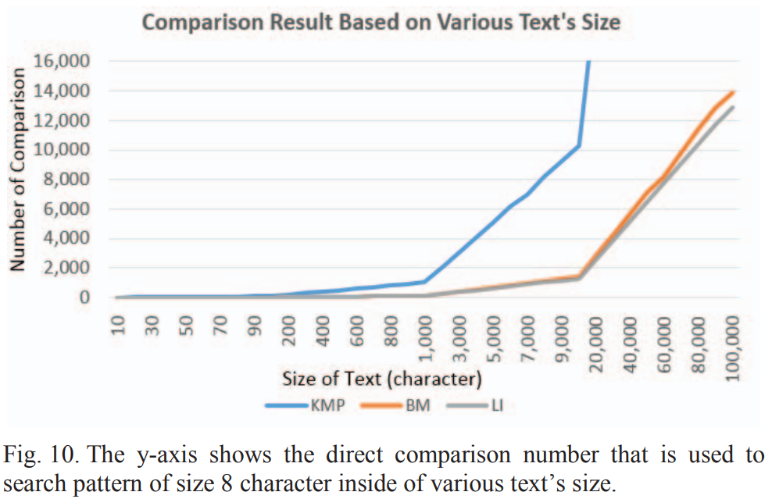
EMPIRICAL EVIDENCE

Slide 32
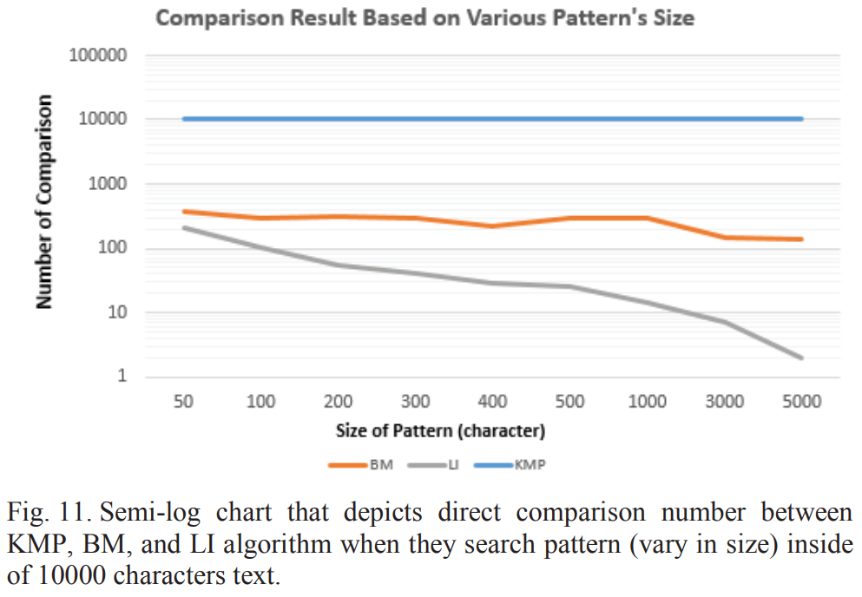
EMPIRICAL EVIDENCE

